Slide 1
Tense
Shallow
Rationally
Nutritious
Essential
Positive
Tired
Proportion
Snarled
Groaned
Stammer
Strain

Slide 2
Personal letters

Slide 3
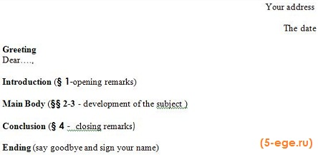

Slide 4
Dear Simon
Thanks for your letter. It was great/lovely to hear from you.
Thanks for sending me…
Please write to me again soon, and tell me all your news.
Hi Simon!
Your last letter was a real surprise.
Wish me luck!
Lots of love,
Drop me a letter when you can.

Slide 5
The most formal
The least formal
a stranger you have spoken to on the phone
A good friend

Slide 6
Thank you for the lesson!

